Slide 1
With the emergence of Covid-19, countries have introduced tracking and control measures that may intrude on individual privacy. Looking ahead to future crises, how should countries approach public health needs vs those of personal privacy?
By Daniel Makarov

Slide 2

What’s a Blockchain?
At its core, a Blockchain is a database. We use it as a digital ledger.
It provides transparency to all actions.
Smart contract compatible.

Slide 3

Why is blockchain important?
Cryptography can be used to protect an individual's privacy.
Countries can distribute & track resources effectively while protecting individual privacy.
Blockchain will create and eliminate careers.

Slide 4
How should countries approach public health needs?
Proper supply chain management is needed for public health satisfaction.
Governments can work together to distribute items equally using blockchains.
Smart contracts can manage the flow of supplies based on the severity of a country's situation, the amount of money chipped in, and their collection.

Slide 5
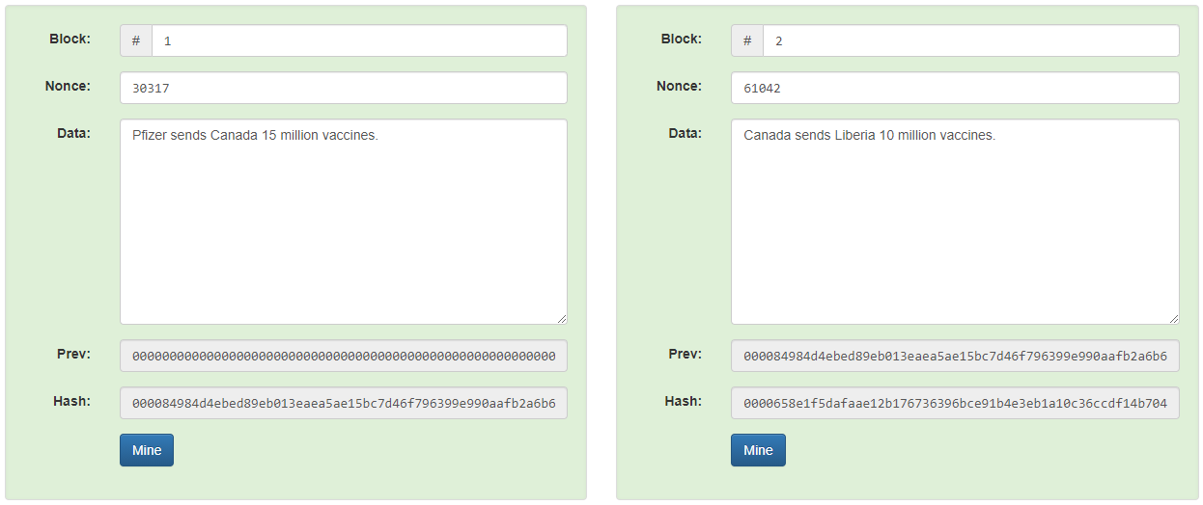
Example of a few transactions on the blockchain:

Slide 6
How should countries approach personal privacy?
Problem: Everyone has access to the blockchain. Everything that happens on a blockchain is recorded and saved. This can cause concern for privacy.
Solution: Provide everyone a public-private key

Slide 7
What’s a private-public key?
Public key: Username
Public key: 0000eb7e1be9d3eb43ba67664cdb973ec77656f5f8c4cce08cfbac4b17b666e3
Private key: Password
Private Key: aFD987e2334e2343254e25Y983r2h98dsu4398008r085438uyr4383457875
Why use them? Public-private keys lessen cyber attacks and give complete control to a person's account. Furthermore, their identity is concealed to the public behind a randomized 64 digit character.

Slide 8

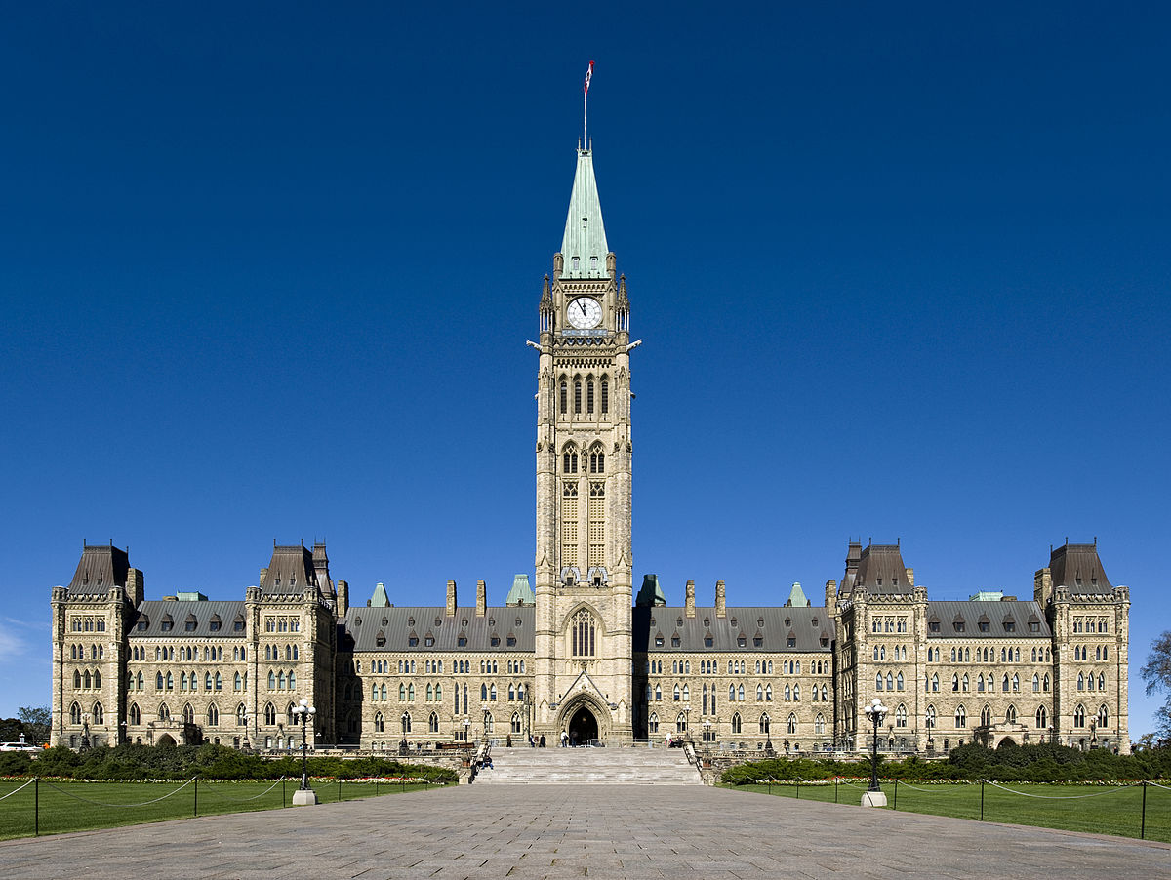
How we can use private public keys:
The Federal Government wants a vaccination status report
You

Slide 9
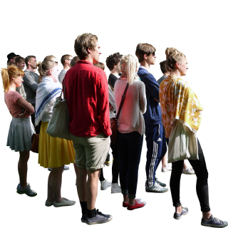


Vaccination Status is uploaded to the blockchain.
Public key
Private Key
Private Key

Slide 10

How can we encourage people to upload their data to blockchains?
By Providing Incentives

Slide 11
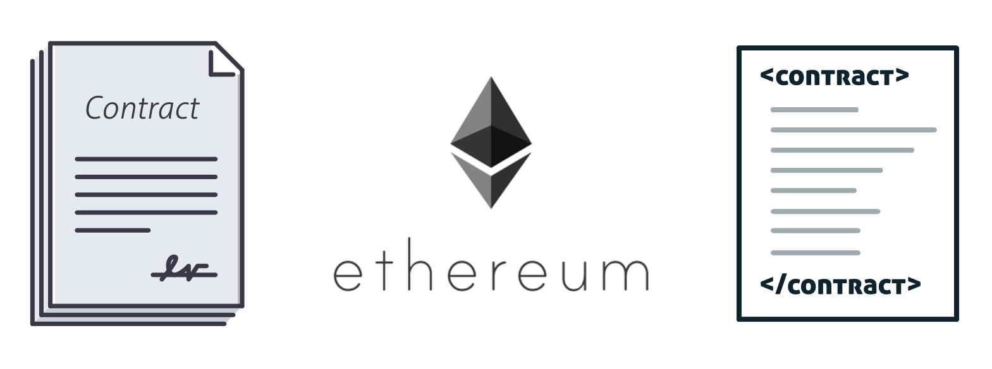
How will blockchain affect the job market?
With the increased use of blockchain technology, blockchain developers, data scientists, machine learning, security, and encryption specialists will be needed to normalize blockchain.
However, intermediaries are at risk of being replaced by smart contracts.

Slide 12
Conclusion
Blockchains will help governments solve global problems.
Blockchains provide data from citizens while keeping anonymity.
To encourage countries & citizens to adopt blockchains, we incentivize them with coins.
People receive incentives for contributing, and the government uses data to solve world problems.
While blockchain will create new careers, some sure will be eradicated.

